Slide 1

The Cost Benefit Analysis of Obtaining Secondary Education
Group 5
Maclean Asante
Jerin Black
Christine Kessler
Sarah Mwanzi

Slide 2
Hypothesis
Going to a university in a western region improves chances of earning a higher starting salary, thus increasing long term earning potential.

Slide 3
Project Proposal
Our project examines the benefits of a university education based on region, cost of attendance, and the return on investment (ROI) in terms of earnings based on starting & mid-career salaries.
Focuses:
Highest starting median salaries & mid-career salaries
Top 30 Colleges
Highest region salary
Overall best region(s) for highest salary/University’s geographic location impact
Best ROI
This topic intrigues us because we’re interested in understanding how higher education impacts our long term earnings potential.

Slide 4
Questions:
What’s the best university to attend for a higher starting & mid-career salary?
Which region gives you the best return on investment (ROI) once graduating from university?
*Assuming you work in the same region after graduating.
Does geographic location of the university have any bearing on the earning potential?
Does a higher tuition cost guarantee a greater ROI?

Slide 5
Data Exploration
We searched major sites (e.g. Bureau of Labor Statistics, Kaggle, PayScale, etc.) to gather data related to higher education. Specifically utilizing sources that included entry-level median salary, cost of tuition, and states/region. Overall, we wanted to focus on what universities would have the best return on investment (ROI) compared to tuition costs.
*Sources are listed on slide 10

Slide 6
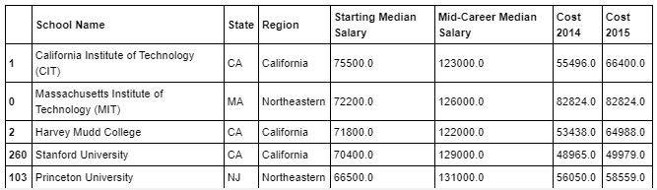
Process: Exploration & Cleanup
Data that is needed to satisfy the questions:
Empirical verifiable information from reliable sources.
Bureau of labor statistics to satisfy salary information
Statistical collected data for university tuition, excluding room/board, financial aid, debt, books & fees
Assumptions that the degree will only take 4 years to complete (I found research that 80% of degree seeking individuals takes an average of 6 years, so need to specify that this is only for 4 years, the additional years increases the tuition cost)

Slide 7
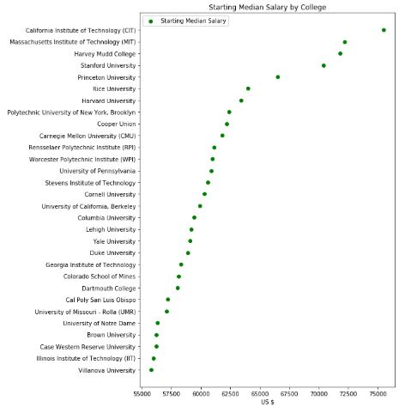
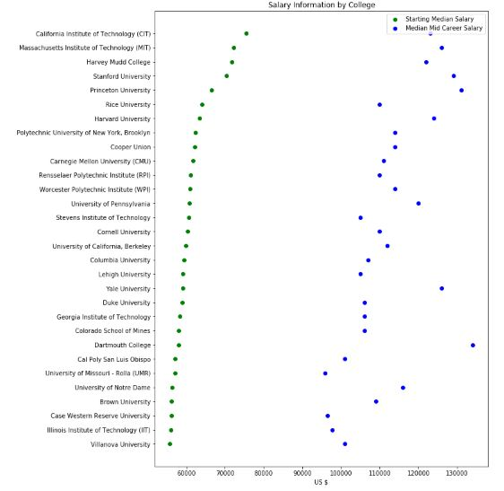
Process: Analysis
An overabundance of information, needed to narrow the scope down.
University names and descriptions were not consistent across platforms
ROI can include many things. Narrowed it down to include only the cost of tuition
Surprisingly, data regarding cost and earnings was consistent across data sources

Slide 8
Findings

Slide 9
Q&A

Slide 10
Sources of Data
Kaggle
https://Kaggle.com/WSJ/college-salaries#salaries-by-region.csv
Salaries by College
Degrees That Pay Back
PayScale
https://www.payscale.com/college-salary-report
Cost Pay Analysis
API
https://data.bls.gov/PDQWeb/LE
Google
Maps

